Slide 2
Meeting Goals
For everyone to walk out with at least one tech integration idea, tool or strategy to use in their classroom.
Share implementation ideas and success stories.
Lessons learned

Slide 3
Comic and Book Creation
Combine descriptive images and meaningful text
You can use a variety of images:
Images from the Internet
Photos saved on your camera roll
Photos taken on your iPad of student work
Images created with Digital drawing Apps

Slide 4
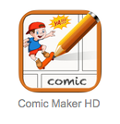

Slide 5
Book Creator

Slide 6
Comic Maker

Slide 7
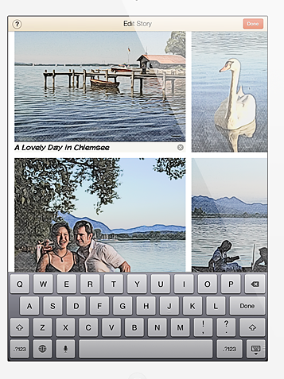
Story Me
Collage, comic strips and cartoons from your own personal photos!

Slide 8
Review from last week
Open up your App store
Search for the App QR Reader and install it.

Slide 9
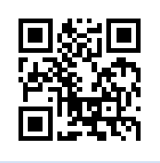

Slide 10
QR (Quick Response) Codes
The codes act as hyperlinks
to data and other resources
for use by students.
Create codes:
www.qrstuff.com

Slide 11
A few reminders
We are only installing Free Apps on student iPads this year.
Please use the feedback form and enter details of your lesson
Review App list or request new Apps through the feedback form at:
http://stlouisparish.org/school/ipads/

Slide 13
Blogs to follow
Rychard Byrne’s Free Technology for Teachers
http://www.freetech4teachers.com/
Wes Fryer’s Moving at the Speed of Creativity
http://www.speedofcreativity.org/

